Slide 1
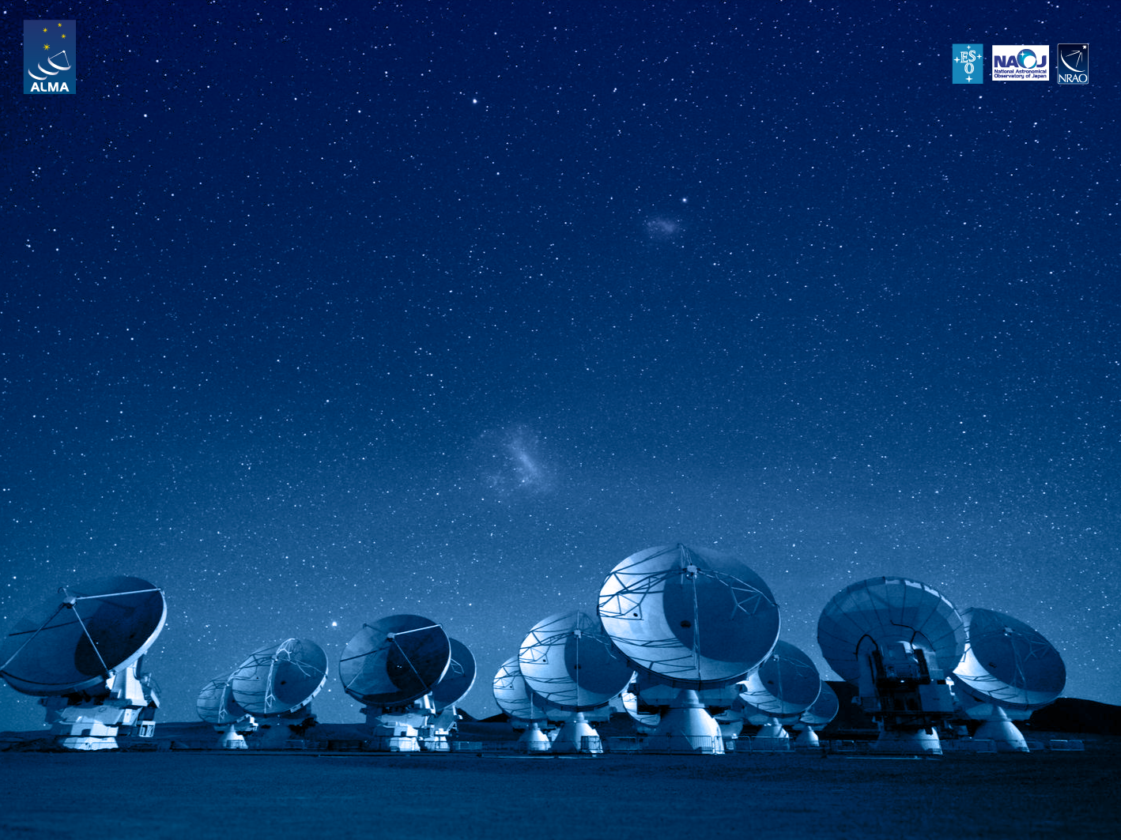
ALMA Common Software Course Project
Observatory Software Toy Model

Slide 2
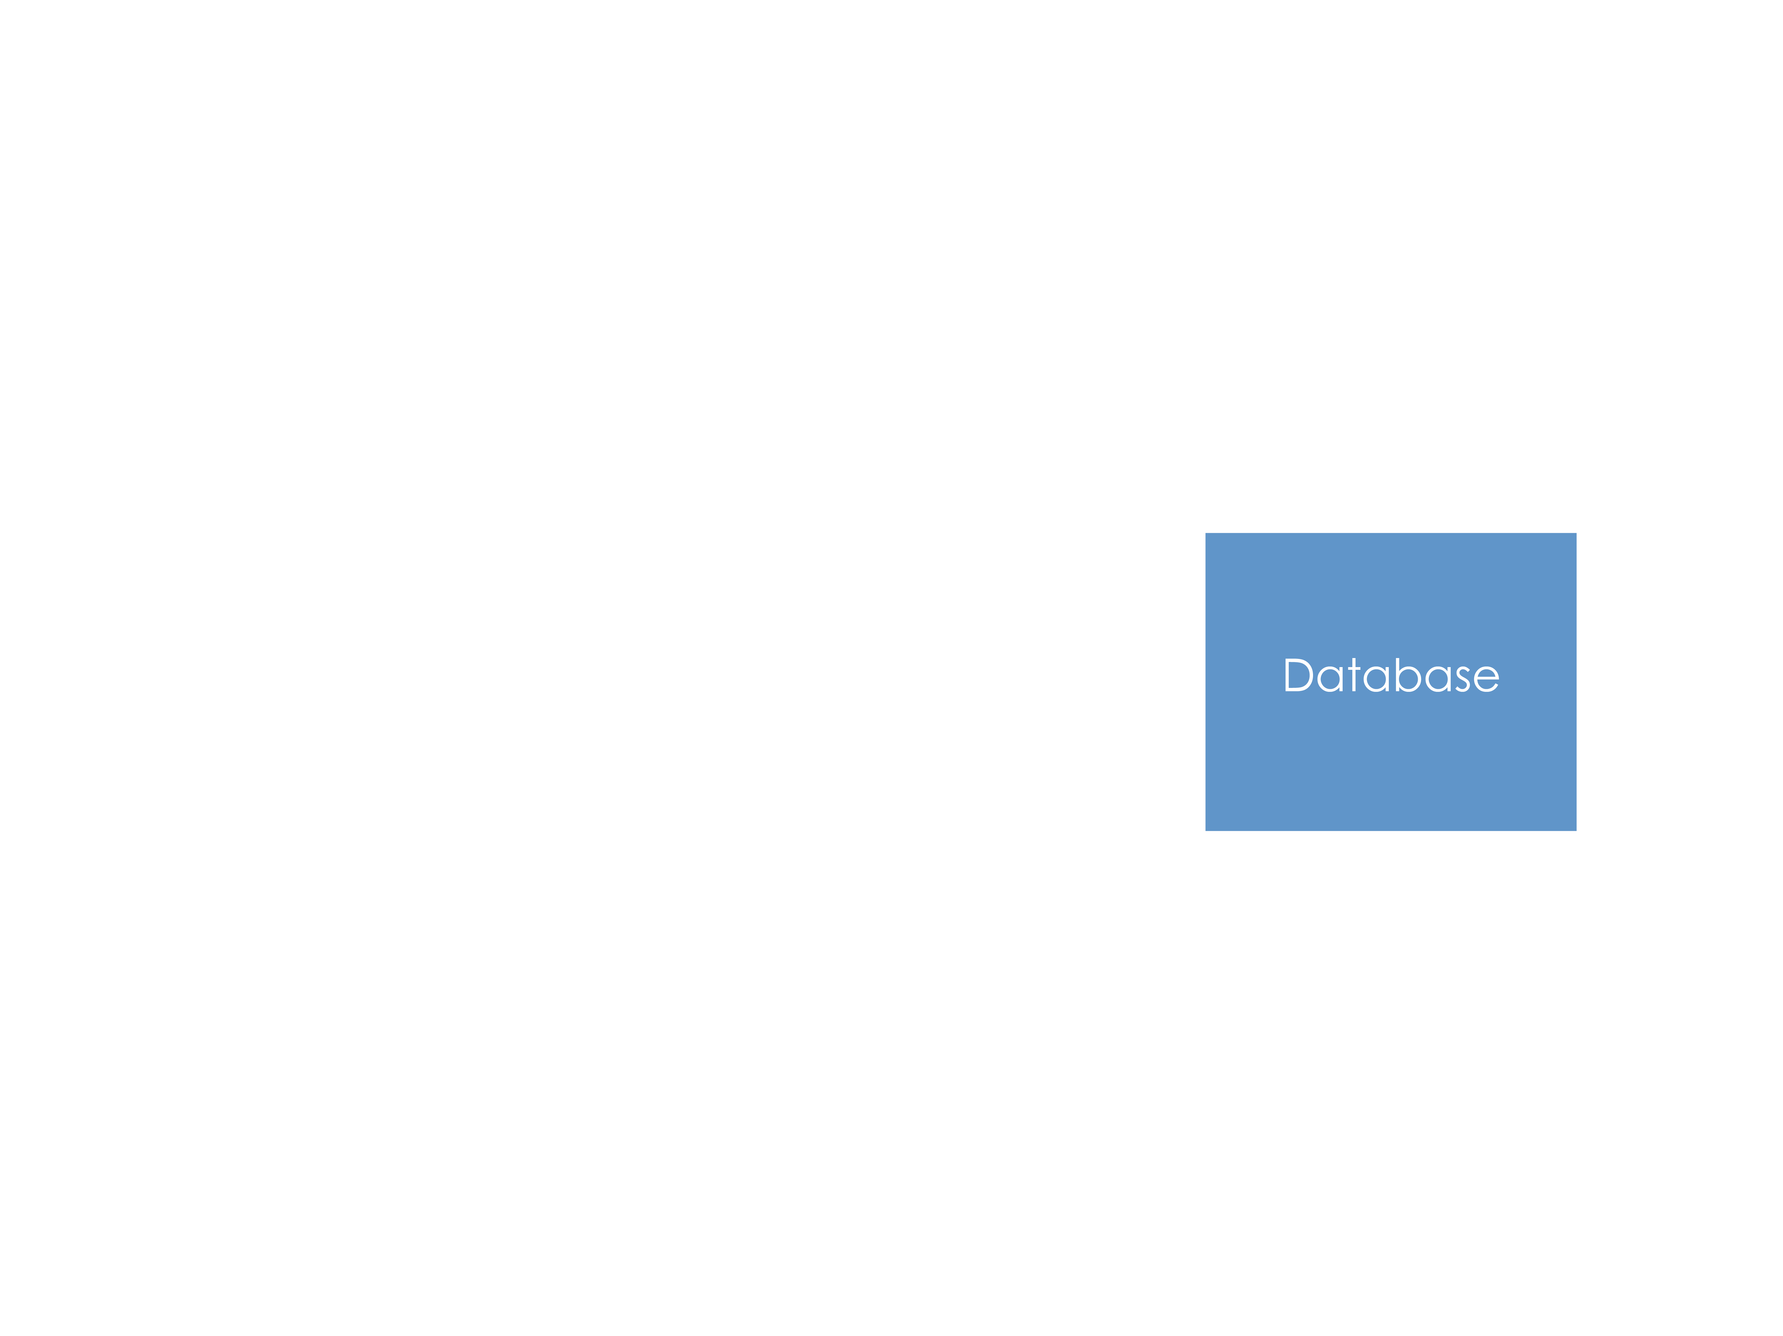
Proposal Lifecycle

Slide 3
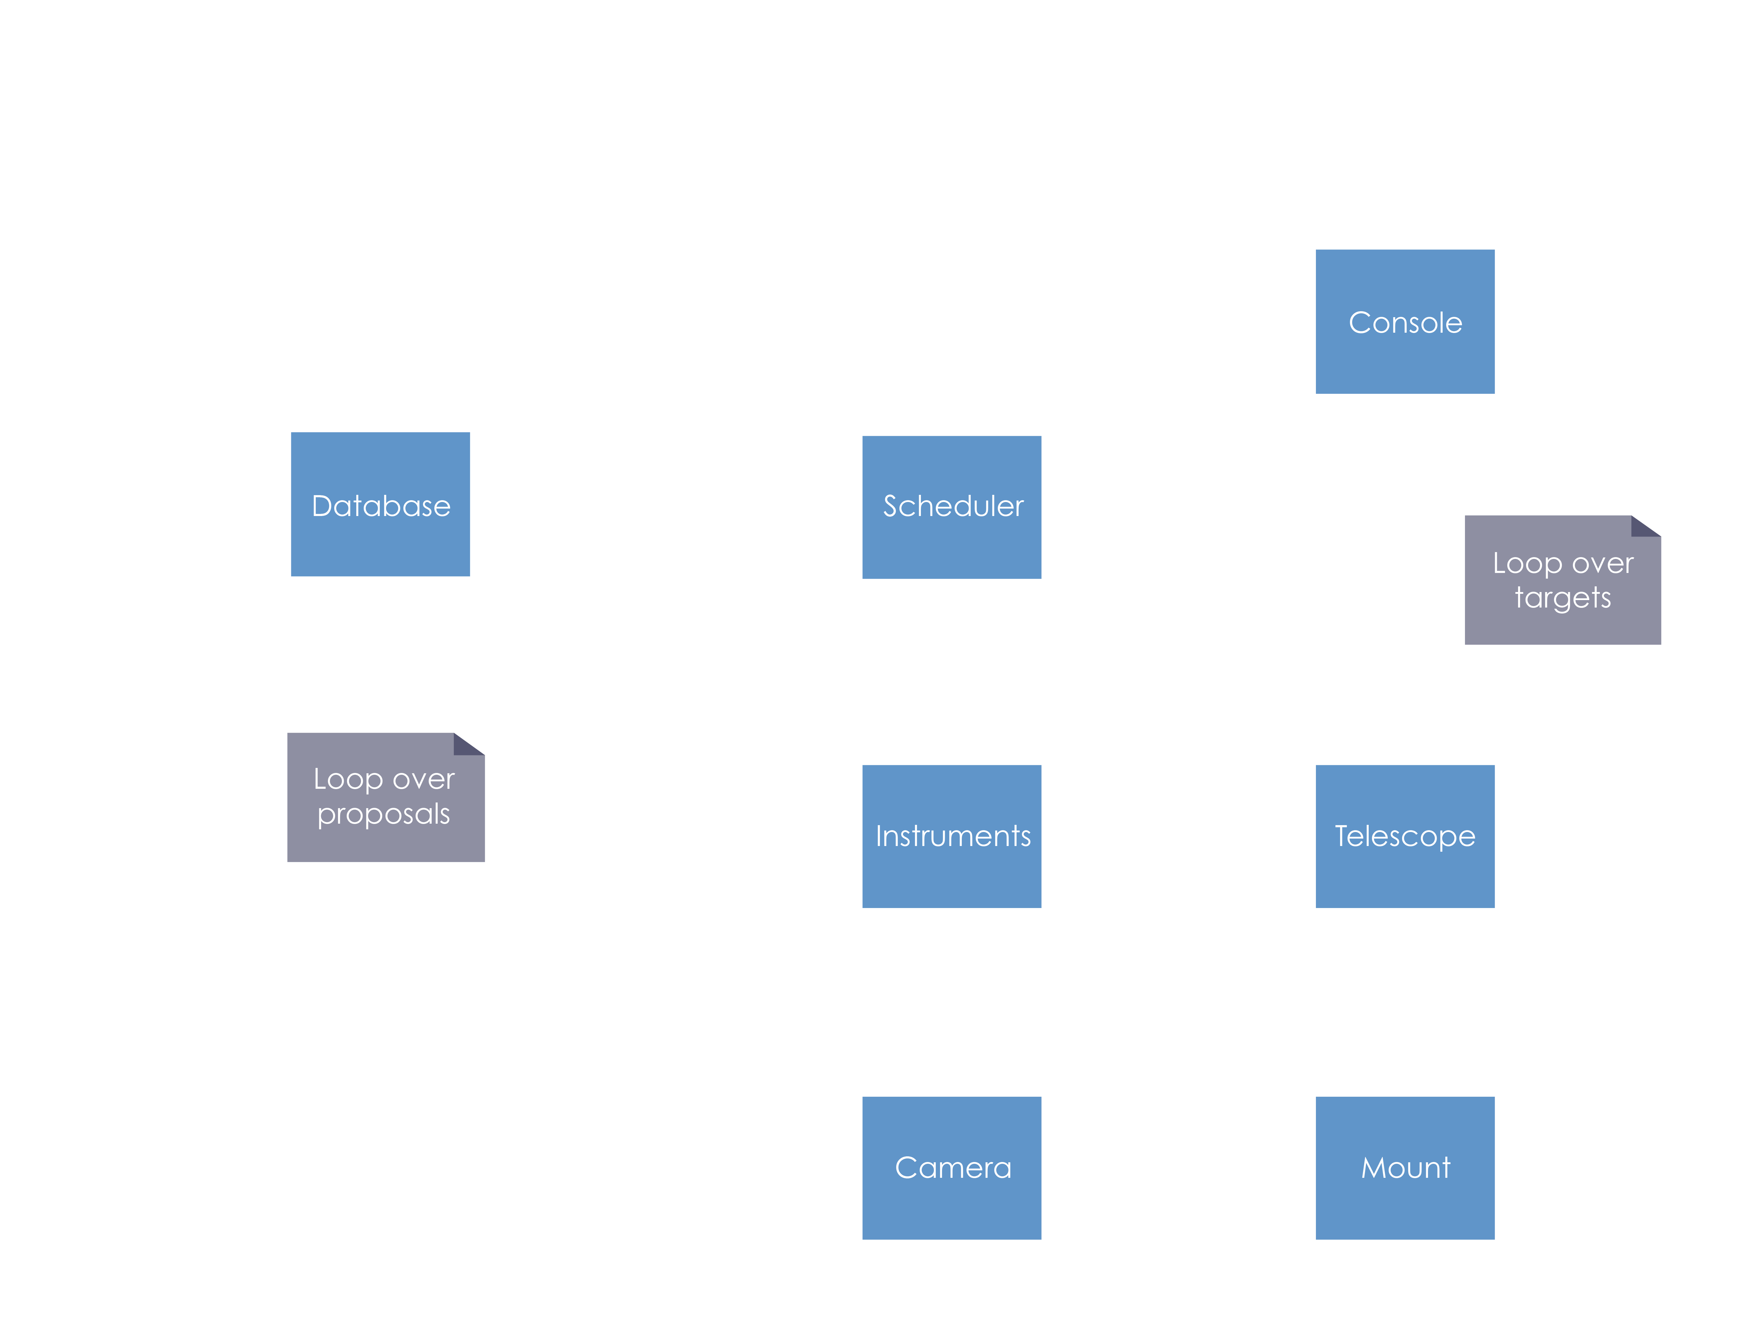
Automatic Proposal Executions

Slide 4
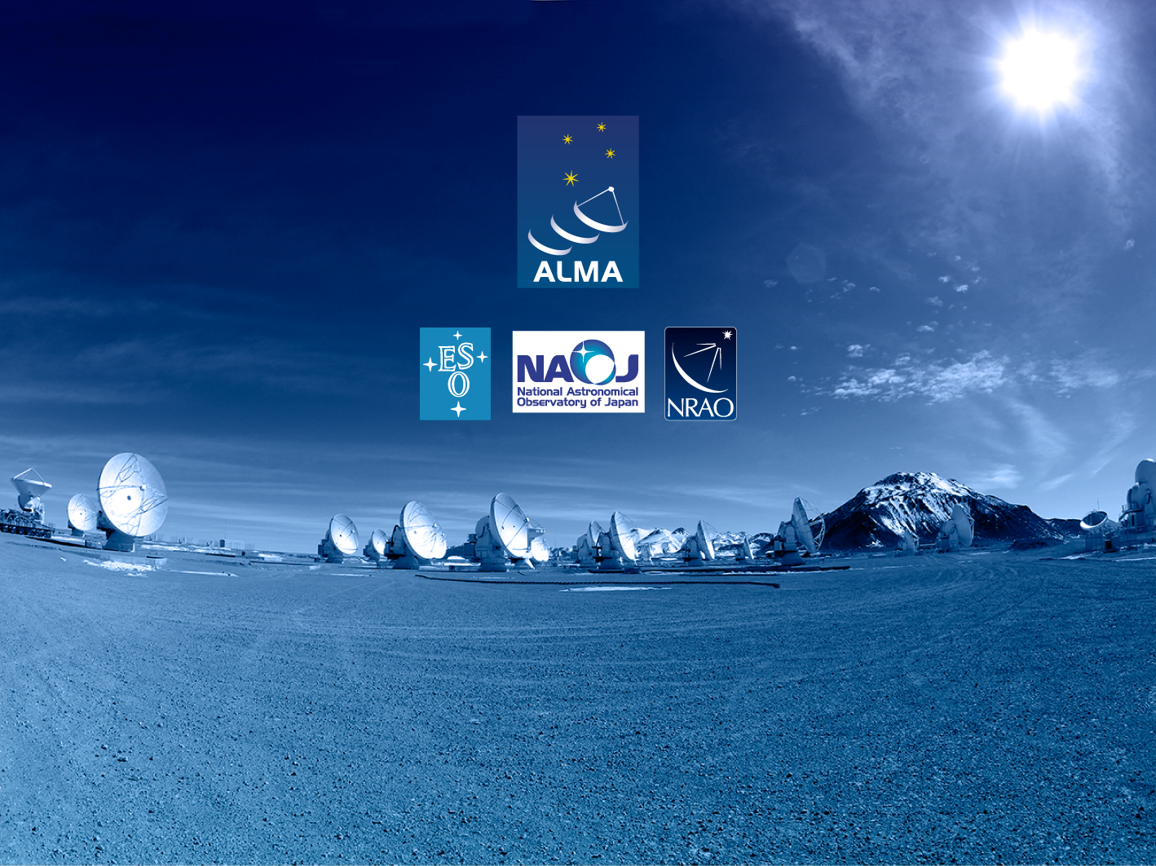
Questions?
Acknowledgements
ACS presentations were originally developed by the ALMA Common Software development team and has been used in many instances of training courses since 2004. Main contributors are (listed in alphabetical order): Jorge Avarias, Alessandro Caproni, Gianluca Chiozzi, Jorge Ibsen, Thomas Jürgens, Matias Mora, Joseph Schwarz, Heiko Sommer.
The Atacama Large Millimeter/submillimeter Array (ALMA), an international astronomy facility, is a partnership of Europe, North America and East Asia in cooperation with the Republic of Chile. ALMA is funded in Europe by the European Organization for Astronomical Research in the Southern Hemisphere (ESO), in North America by the U.S. National Science Foundation (NSF) in cooperation with the National Research Council of Canada (NRC) and the National Science Council of Taiwan (NSC) and in East Asia by the National Institutes of Natural Sciences (NINS) of Japan in cooperation with the Academia Sinica (AS) in Taiwan. ALMA construction and operations are led on behalf of Europe by ESO, on behalf of North America by the National Radio Astronomy Observatory (NRAO), which is managed by Associated Universities, Inc. (AUI) and on behalf of East Asia by the National Astronomical Observatory of Japan (NAOJ). The Joint ALMA Observatory (JAO) provides the unified leadership and management of the construction, commissioning and operation of ALMA.

